Slide 1
After completing this virtual lab you should:
Be able to interpret the phylogenetic tree of plants
Know the terms in bold and be able to identify them on a plant diagram or photograph
Know the functions of the plant parts
Be able to distinguish a monocot from a dicot
Instructions for Plants Exercise
Read the “Background” section in the worksheet, referring to the pictures in this ppt.
Complete the questions /label diagrams at the end.

Slide 2
Plants are eukaryotic, multicellular organisms classified within the Domain Eukarya, Kingdom Plantae. They have cell walls made of cellulose, contain chlorophyll, are autotrophs, and live in water (Charophyta) or on land (Embryophyta). Plants are divided into Vascular and nonvascular plants.
The vascular plants are the Ferns (seedless), the gymnosperms (seed, non-flowering), and the angiosperms (seed, flowering)
The flowering plants are further divided into two groups: the Monocotyledons, and the Dicotyledons

Slide 3
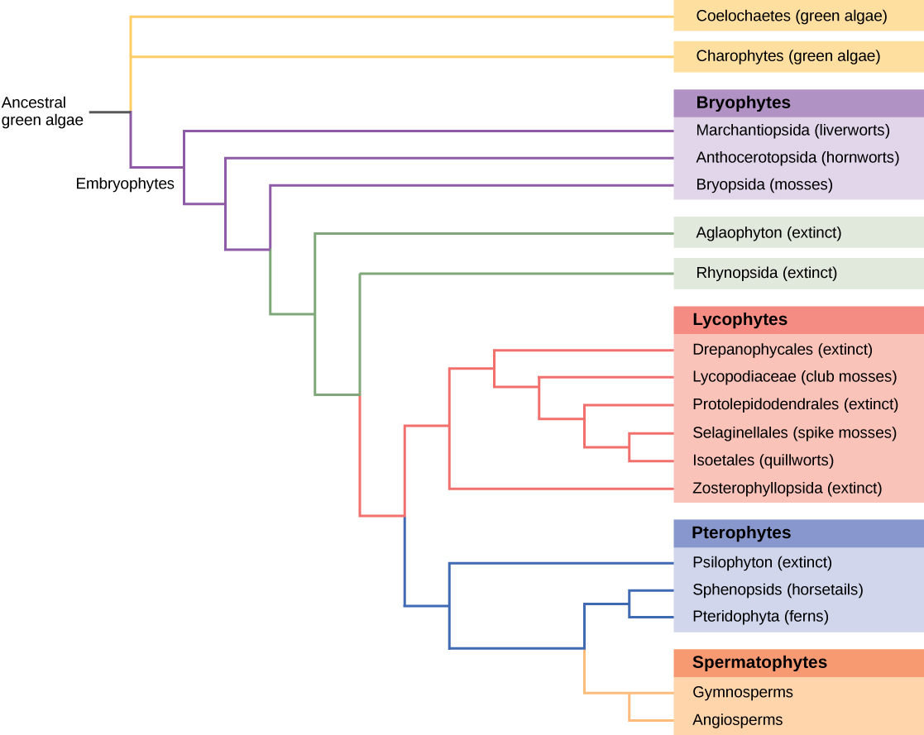
Figure 1: evolutionary relationships of plants.
Non-vascular plants (Mosses)
Seedless vascular plants (Ferns)
Vascular plants with naked seed (Conifers and Allies)
Monocots
Vascular plants with coated seed and flowers
Dicots

Slide 4
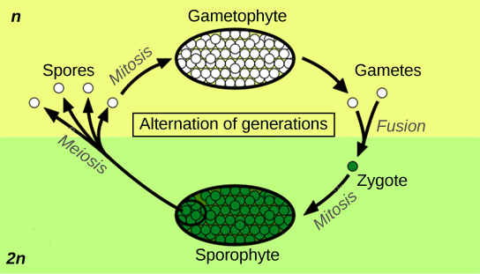
Figure 2. The generalized life cycle of plants: alternation of generations
All plants undergo alternation of generations between the 1n gametophyte and 2n sporophyte in their life cycle. In flowering plants, the gametophytes are microscopic, and are called pollen (male) and megaspore (female). They are found in the flower, and can’t live independent of the plant. The sporophyte is the visible plant. (credit: Peter Coxhead)

Slide 5
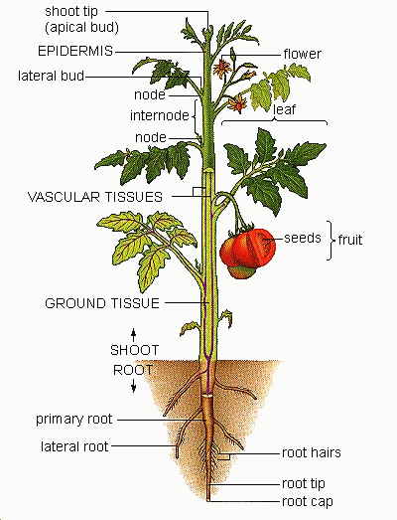
Figure 3: parts of a flowering plant

Slide 6
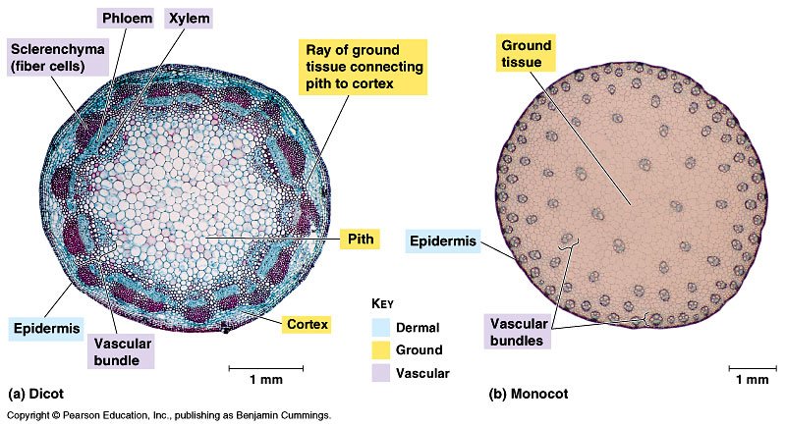
Figure 4: Comparison of stems from monocot and dicot flowering plants with labeled parts

Slide 7
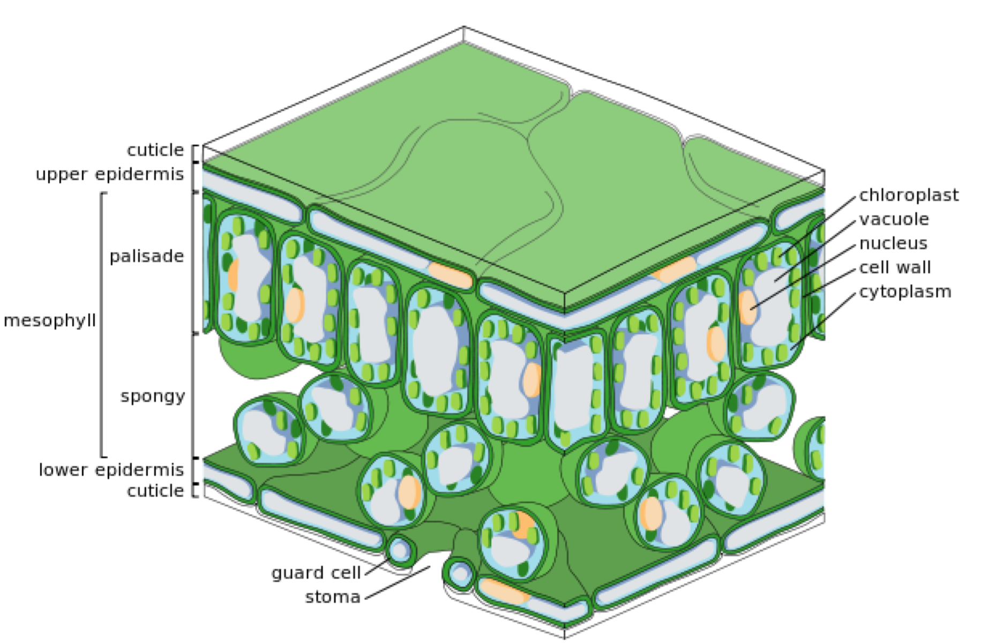
Figure 5: Cross-section diagram of a leaf showing parts.

Slide 8
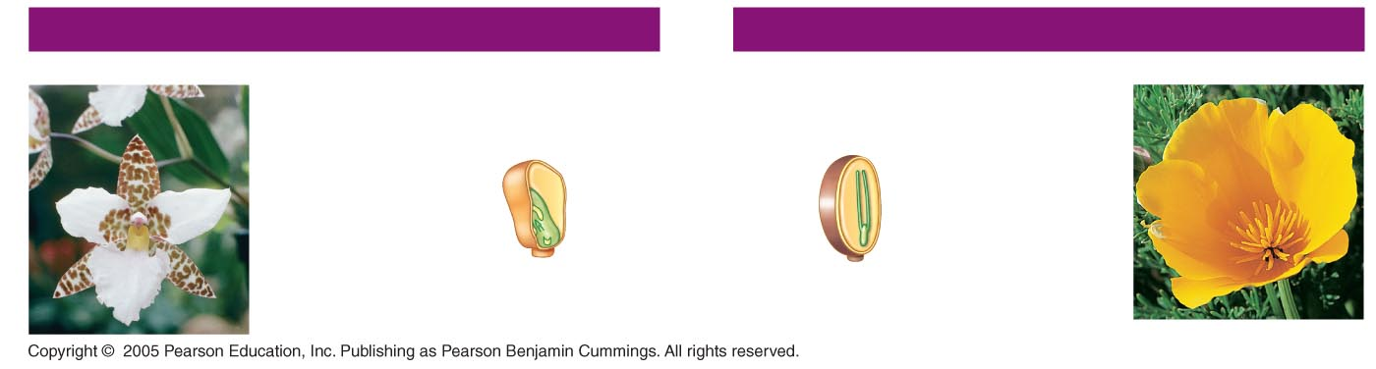
Figure 6: Distinguishing features of monocot and dicot flowering plants
MONOCOTS
EUDICOTS
Orchid
(Lemboglossum
rossii)
Monocot
Characteristics
Eudicot
Characteristics
California
poppy
(Eschscholzia
california)
Embryos
One cotyledon
Two cotyledons

Slide 9
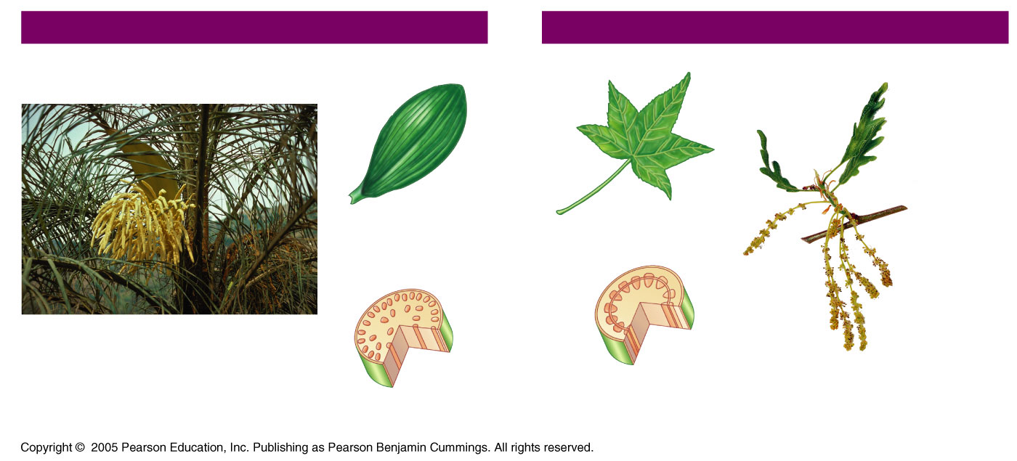
Figure 7: Distinguishing features of monocot and dicot flowering plants
MONOCOTS
EUDICOTS
Leaf
venation
Pyrenean oak
(Quercus
pyrenaica)
Veins usually
parallel
Veins usually
netlike
Stems
Pygmy date palm (Phoenix roebelenii)
Vascular tissue
usually arranged
in ring
Vascular tissue
scattered

Slide 10
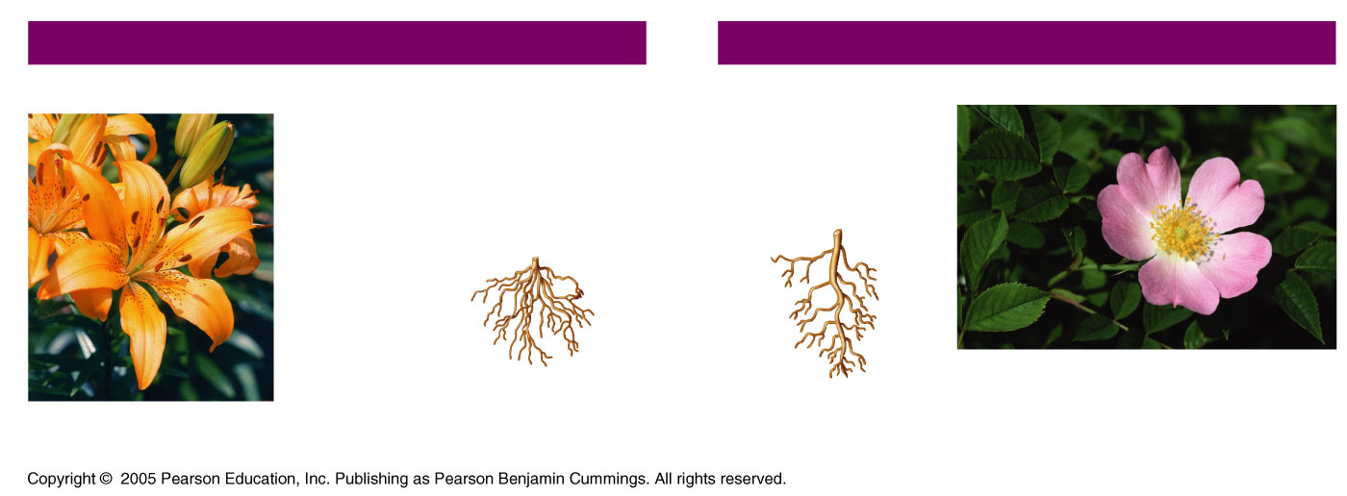
Figure 8: Distinguishing features of monocot and dicot flowering plants
MONOCOTS
EUDICOTS
Lily (Lilium
“Enchantment”)
Roots
Dog rose (Rosa canina), a wild rose
Root system
usually fibrous
(no main root)
Taproot (main root)
usually present

Slide 11
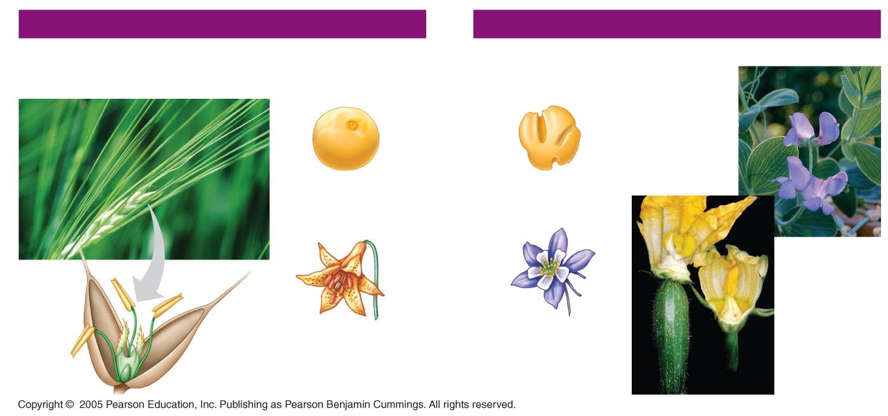
Figure 9: Distinguishing features of monocot and dicot flowering plants
MONOCOTS
EUDICOTS
Barley (Hordeum vulgare), a grass
Pea
(Lathyrusner
vosus, Lord
Anson’s
blue pea),
a legume
Pollen
Pollen grain with
one opening
Pollen grain with
three openings
Flowers
Anther
Zucchini
(Cucurbita
Pepo), female
(left), and
male flowers
Stigma
Floral organs
usually in three or
multiples of three
Floral organs usually
In
four or five
Filament
Ovary

Slide 12
Plant selection: video on corn domestication
Watch the following video. Answer the questions on the lab report
https://www.biointeractive.org/classroom-resources/popped-secret-mysterious-origin-corn

